Slide 1
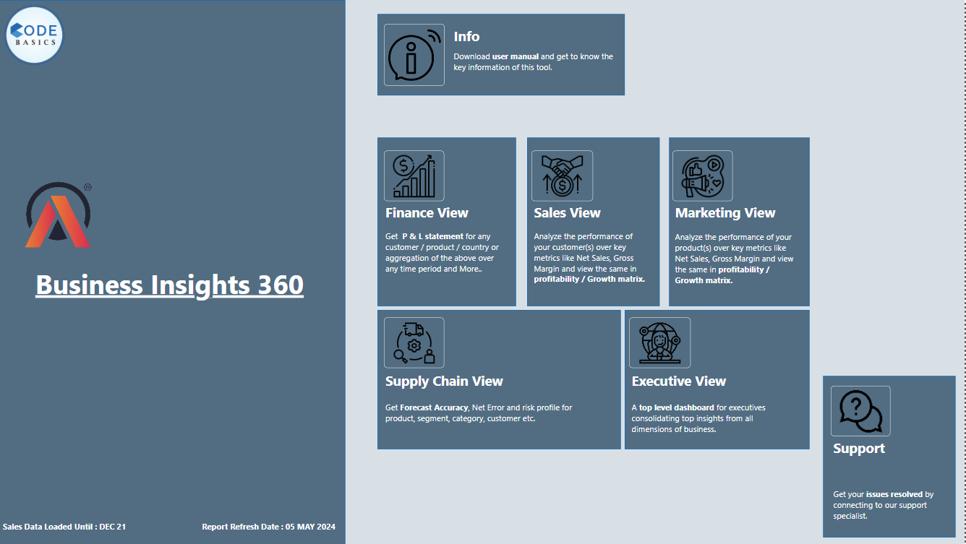

Slide 2



AtliQ Hardware
Problem Statement
AtliQ Hardware is a consumer goods electronics company having operations in various countries. Their business is growing rapidly and they still rely on excel files for data analytics. Excel files are hard to consume and not effective in generating insights. Also due to the lack of effective analytics the company faced a major loss in Latin America.

Slide 3


AtliQ Hardware
Data collection and transformation
Extracted Data from MY SQL Database and CSV file.
Data cleaning done using power Query.
Created columns using power query.
Created various Dax measures.
Created date dimension table using M language and Power Query.
MY SQL DATABASE
EXCEL
(.CSV file)

Slide 4
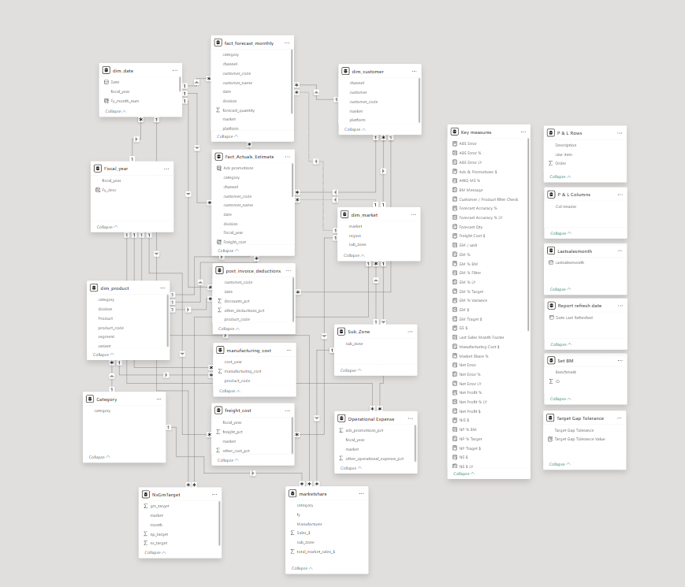
AtliQ Hardware
Data Modelling
One to Many relationship Using Snowflake Schema

Slide 5
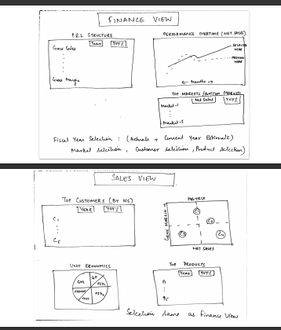
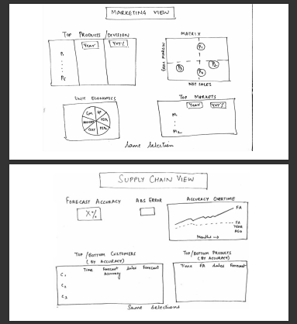
AtliQ Hardware
Rough Mockups

Slide 6
AtliQ Hardware
Report Design
Finance view To show P & L Statements to understand Financial Performance Across
Markets, Products, Customers etc.
Sales View : To show Top/Bottom Customers along with Key metrics. A Matrix would be preferrable to understand the performance.
Marketing view : To show Top/Bottom Products along with Key metrics.
Supply Chain view : Reliability, Forecast Accuracy in a view to understand sales and Customer Performance.
Executive View : Integrated view of key insights for Executives.

Slide 7


